Slide 1

HVAC Energy Consumption Prediction using Machine Learning
Leveraging data science to optimize building energy efficiency and reduce operational costs
Swapnil Gadekar

Slide 2


PROBLEM STATEMENT
The Challenge of Energy Inefficiency
Rising Energy Costs
HVAC systems account for 40-50% of total building energy consumption, making them the largest energy expense in commercial facilities.
Without predictive insights, buildings operate reactively rather than proactively, leading to:
Excessive energy waste during off-peak hours
Unpredictable utility expenses
Environmental impact from unnecessary consumption
Swapnil Gadekar

Slide 3

Project Objective
Primary Goal
Expected Outcome
Real-World Impact
Develop a machine learning model that accurately predicts HVAC energy consumption based on environmental and operational factors.
Transform reactive building management into proactive energy optimization, resulting in significant cost savings and reduced carbon footprint.
Enable facility managers to optimize HVAC scheduling, reduce energy waste, and lower operational costs through data-driven decision making.
Swapnil Gadekar

Slide 4





Dataset Overview
Key Features
Temperature
Our dataset captures the critical variables that influence HVAC energy consumption in real-time.
Ambient and outdoor temperature readings
By analyzing the relationship between environmental conditions, occupancy patterns, and energy usage, we can build a robust predictive model.
Humidity
This comprehensive approach ensures accurate forecasting across various operational scenarios.
Relative humidity levels affecting cooling demands
Occupancy
Building occupancy patterns and headcount
Energy Output
Historical HVAC energy consumption data
Swapnil Gadekar

Slide 5







TECHNICAL APPROACH
Methodology
Data Collection
Preprocessing
Train-Test Split
Random Forest Train
Evaluation
We implemented a systematic machine learning pipeline using Random Forest Regressor, chosen for its ability to handle complex non-linear relationships and provide robust predictions with minimal hyperparameter tuning.
Swapnil Gadekar

Slide 6
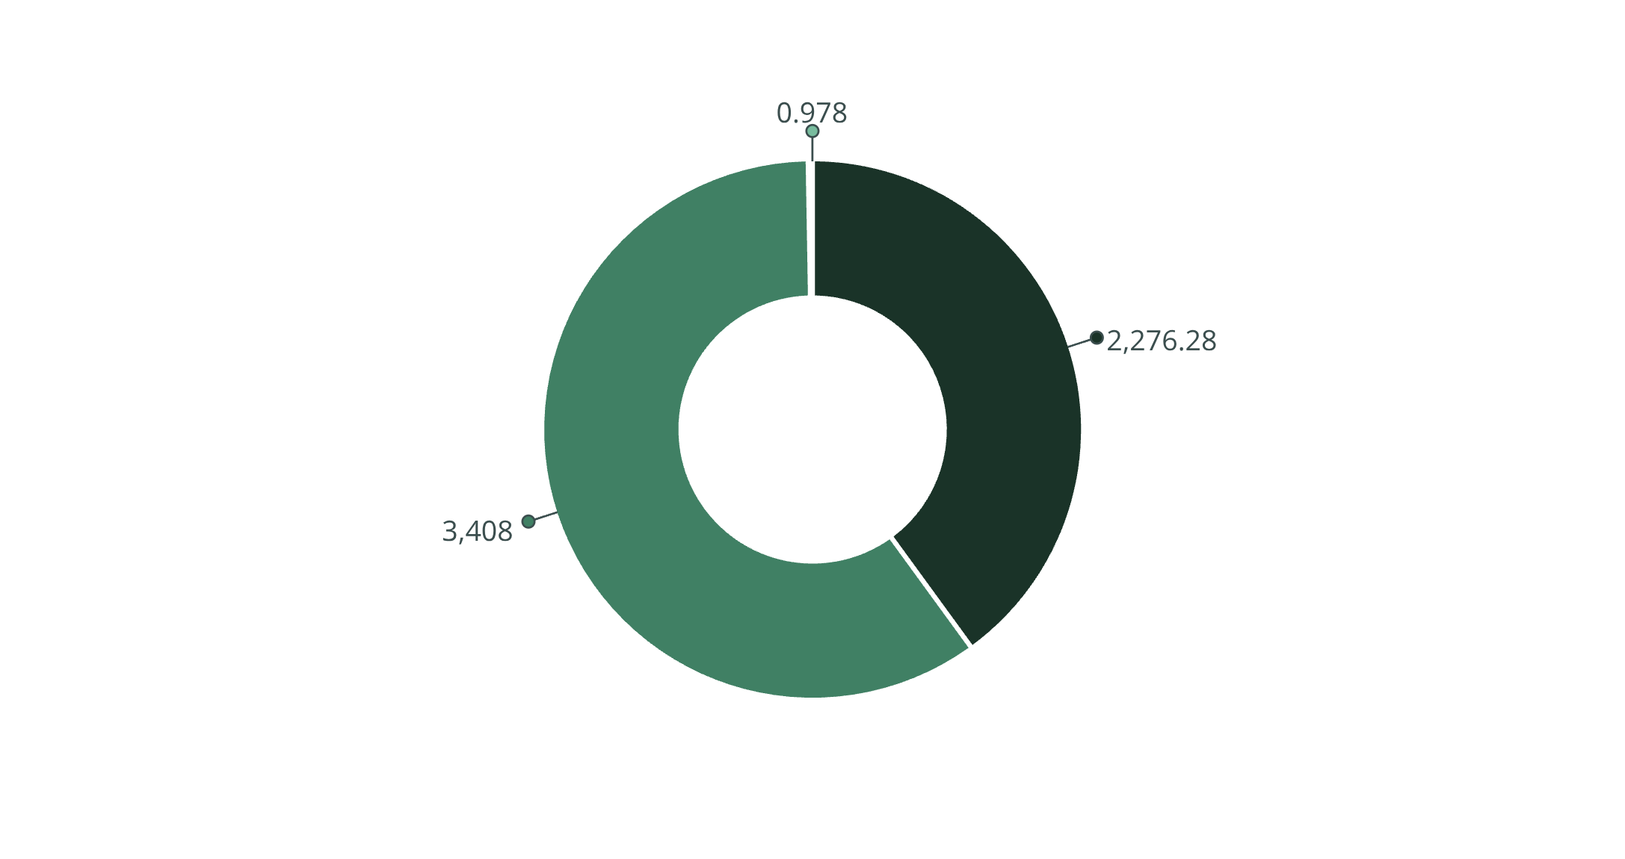

Model Performance Results
Our Random Forest model demonstrated exceptional predictive accuracy, achieving an R² score of 0.9775, which indicates that the model explains 97.75% of the variance in HVAC energy consumption.
The low error metrics confirm the model's reliability for real-world deployment in building management systems.
MAE
RMSE
R² Score

Slide 7




Insights & Real-World Impact
Cost Reduction
Environmental Benefits
Operational Efficiency
Predictive insights enable 15-20% reduction in energy costs through optimized HVAC scheduling and proactive adjustments.
Lower energy consumption directly translates to reduced carbon emissions, supporting corporate sustainability goals.
Data-driven decision making empowers facility managers to maintain optimal comfort while minimizing waste.
Swapnil Gadekar

Slide 8


Model Interpretation
What the Numbers Mean
Mean Absolute Error (MAE): 2,276 kWh – On average, predictions deviate by about 2,276 kWh from actual consumption, which is minimal for typical commercial buildings.
R² Score: 0.9775 – The model captures nearly 98% of energy consumption patterns, demonstrating excellent predictive power and reliability.

Slide 9


KEY TAKEAWAY
Impact Summary
Proven Accuracy
Cost Savings
Scalable Solution
97.75% prediction accuracy enables confident deployment in production environments
Potential 15-20% reduction in energy expenses for commercial facilities
Model can be adapted across different building types and climate zones
Machine learning transforms HVAC management from reactive to predictive, unlocking substantial energy and cost savings while reducing environmental impact.
Swapnil Gadekar

Slide 10





Future Scope & Next Steps
Weather Integration
Real-Time Integration
Incorporate weather forecasts to anticipate energy demands days in advance
Deploy model with IoT sensors for live predictions and automated HVAC adjustments
Multi-Building Scale
Deep Learning
Expand to portfolio-level optimization across multiple facilities and campus environments
Explore LSTM networks to capture complex temporal patterns and seasonal variations
Swapnil Gadekar

